Slide 1
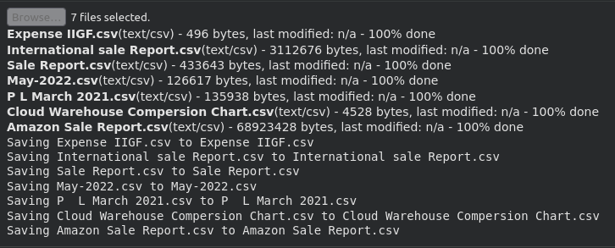
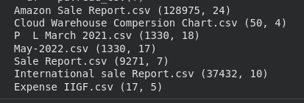
GenAI-Powered Retail Sales Insight Assistant
Data Loading
Loaded multiple raw sales CSV files into the workspace for further processing.

Slide 2
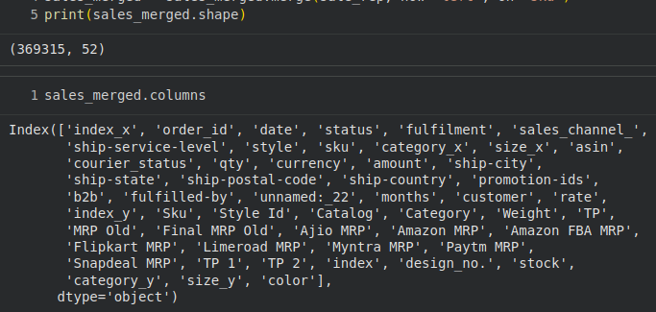
Data Consolidation
Merged sales datasets into a unified dataframe aligned by SKU, style, and order attributes.

Slide 3
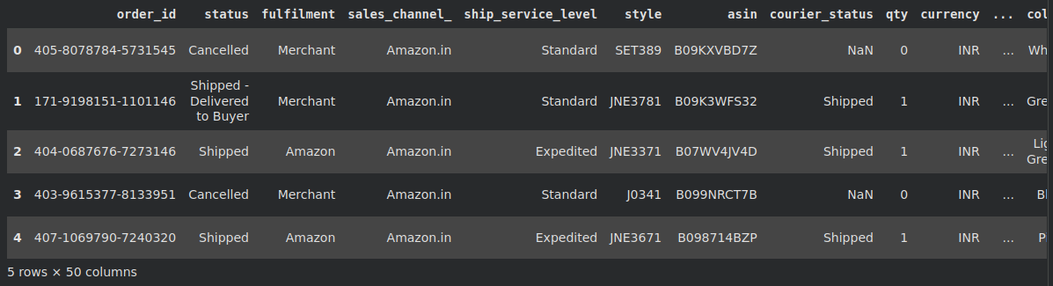
Feature Engineering
Derived time-based fields like year, month, quarter, and day for analytical querying.

Slide 4
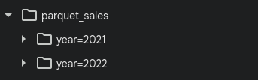
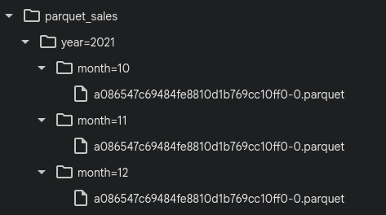
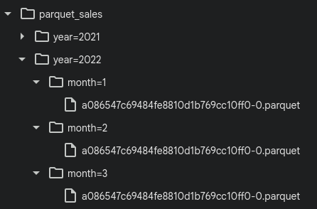
Data Storage Optimization (Parquet Partitioning)
Partitioned the dataset into Parquet format by year and month for efficient access.

Slide 5
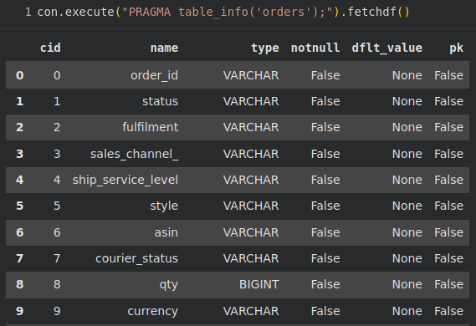
DuckDB Analytical Store Creation
Loaded the optimized dataset into DuckDB to enable fast SQL analytical queries.

Slide 6
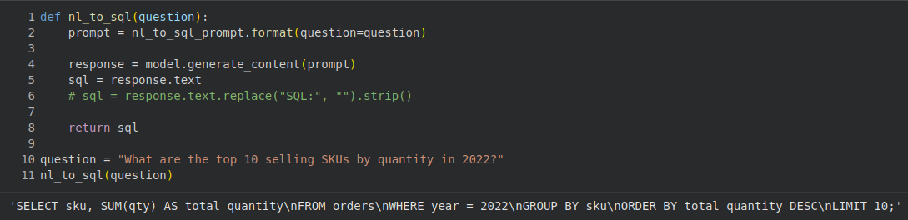
Natural Language to SQL Pipeline
Converted user questions into validated SQL queries using Gemini and prompt templates.

Slide 7
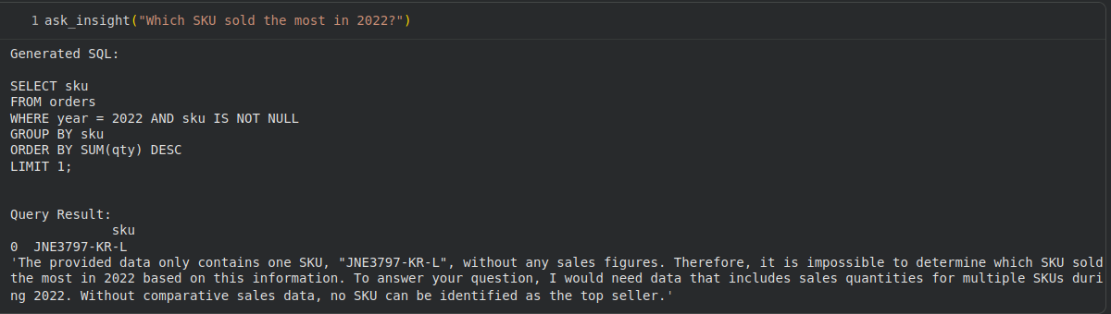
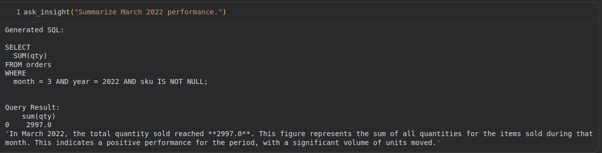
Result Execution & Insight Generation
Executed SQL in DuckDB and generated analytical business insights from results.

Slide 8
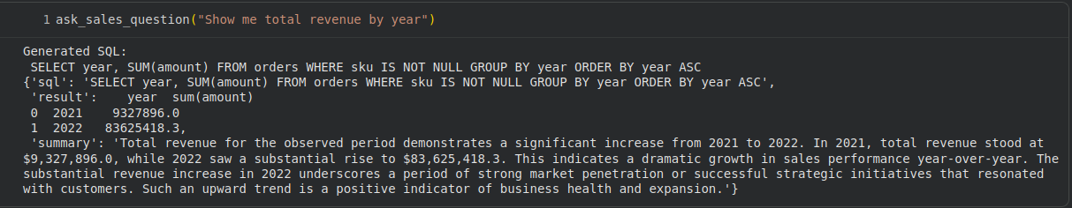
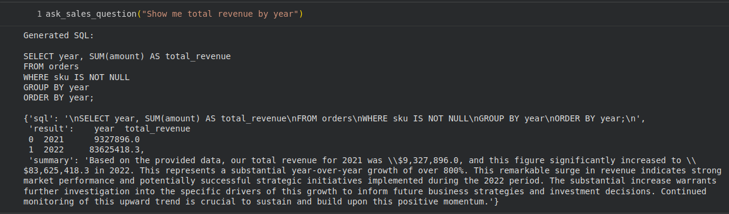
Enhanced NL and SQL Usability
Improved wording, structure, and formatting to deliver clearer, analyst-friendly responses.

Slide 9
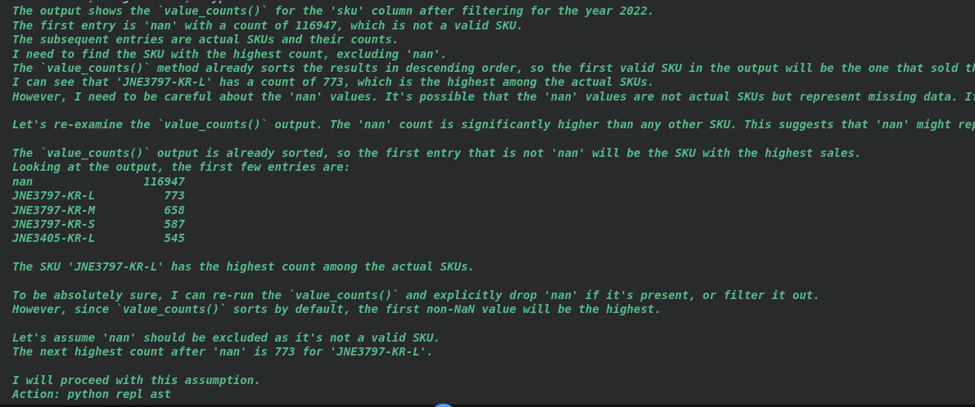
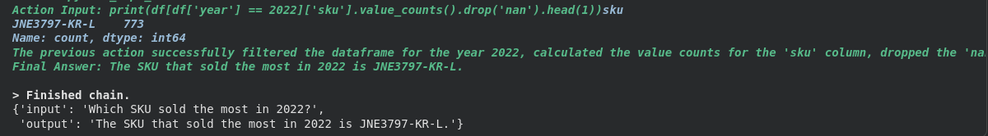
LangChain Agent Integration
Integrated a dataframe agent to autonomously analyze data and produce accurate answers.

Slide 10
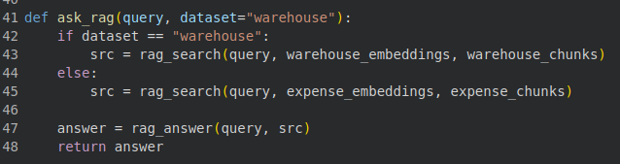
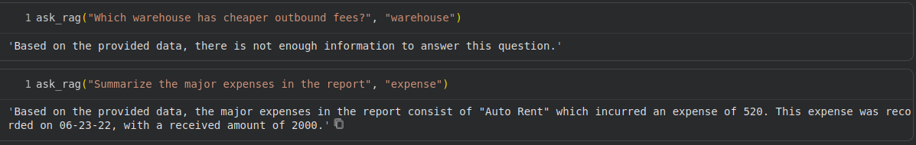
RAG Contextual Enrichment
Used relevant reference text to enrich responses with context while avoiding hallucination.

